Slide 1

COGNIFYZ TECH
2024-2025
A PROJECT TITLE
“STOCK MARKET ANALYSIS Using Power BI ”
PRESENTED BY - C.RAMANATHAN

Slide 2
DATA PREPARATION OVERVIEW
To begin with, I want to outline the steps we took to prepare the data for analysis. Our initial data load involved consolidating multiple sources to ensure we had a comprehensive dataset. We then performed a thorough clean-up to address any inconsistencies or errors. This included:
Removing Duplicates: We identified and eliminated duplicate entries to ensure each data point was unique.
Handling Missing Values: We filled in missing values using appropriate methods based on the data type and context.
Data Validation: We cross-checked data entries against known benchmarks to ensure accuracy.
With the data cleaned and validated, we proceeded to the analysis, which was guided by the task specified you asked.

Slide 3
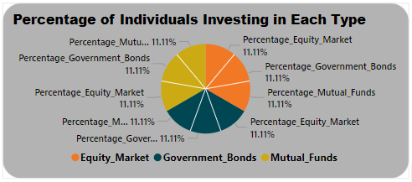
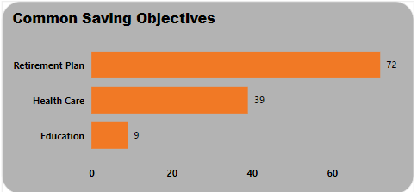
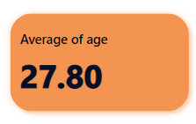
1. DATA EXPLORATION AND SUMMARY:
Calculate Statistics:
Compute average age.
Percentage of individuals with various investments.
Common savings objectives.
The Average age of People is 27.80.
The Percentage of individuals investing in each type 11.11%.
The Retirement plan is a Major part of common saving objectives.

Slide 4
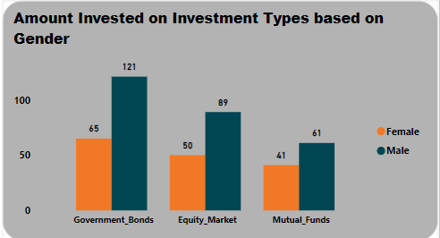
2. GENDER BASED ANALYSIS:
Visual Comparison
Create charts comparing investment choices (equity, mutual funds, government bonds) based on gender.
From the above analysis shows that government bond is most investment choices based on gender for amount investment.

Slide 5
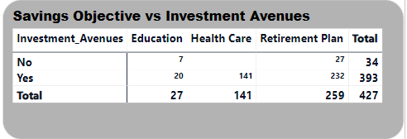
3. OBJECTIVE ANALYSIS:
Explore the correlation between savings objectives (e.g., Capital Appreciation) and investment avenues (e.g., Equity).

Slide 6
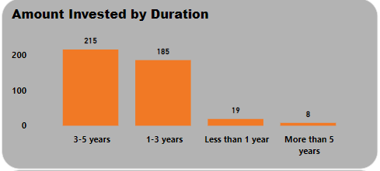
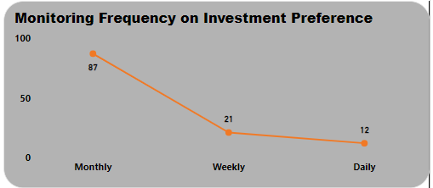
4. INVESTMENT DURATION AND FREQUENCY:
Duration Distribution: Visualize the distribution of investment durations.
Frequency Analysis: Examine investment monitoring frequencies and their impact on investment preferences.
The Gender are choosing 3-5 years as a maximum duration for a distribution of investment.
The Examine investment monitoring frequency on investment preference is Monthly wise.

Slide 7
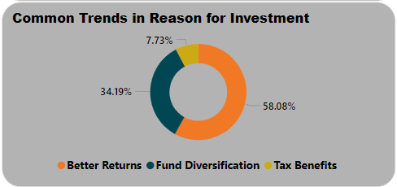
5. REASON FOR INVESTMENT:
Trend Analysis: Identify common trends in reasons for investment.
The Reason for investing the amount in the stock market is to get Better Returns from the stock market is the common trends for investment.

Slide 8
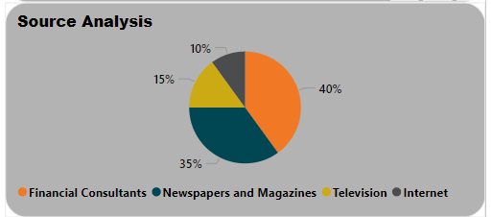
6. SOURCE OF INFORMATION:
Source Analysis: Visualize where individuals get their investment information (e.g., News papers, Internet).
The investor gets most of their investment information from the Television (40%).

Slide 9
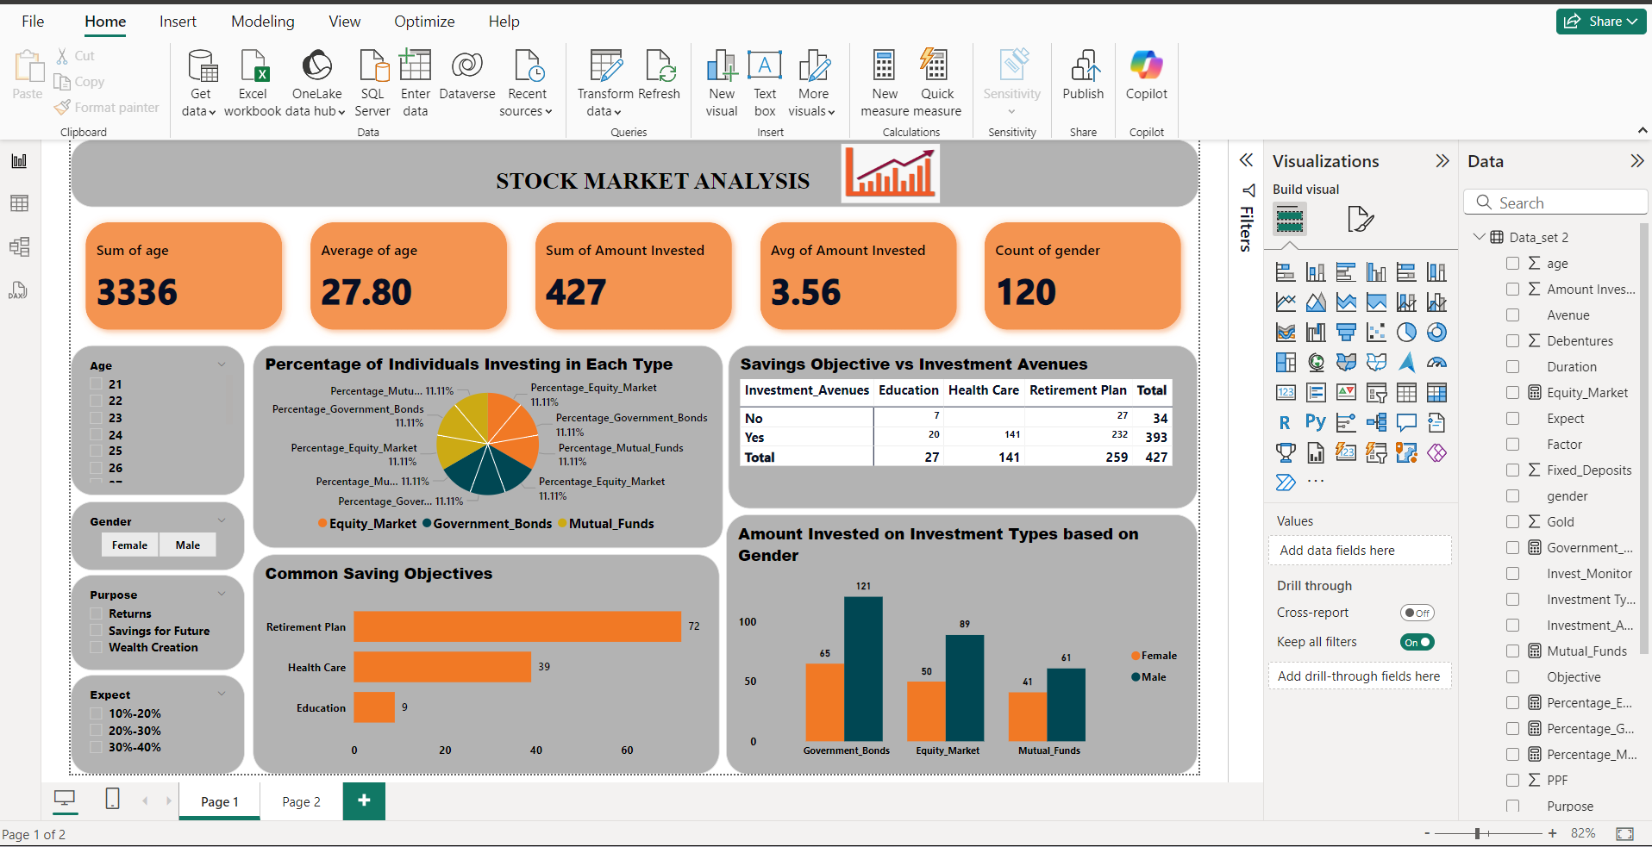
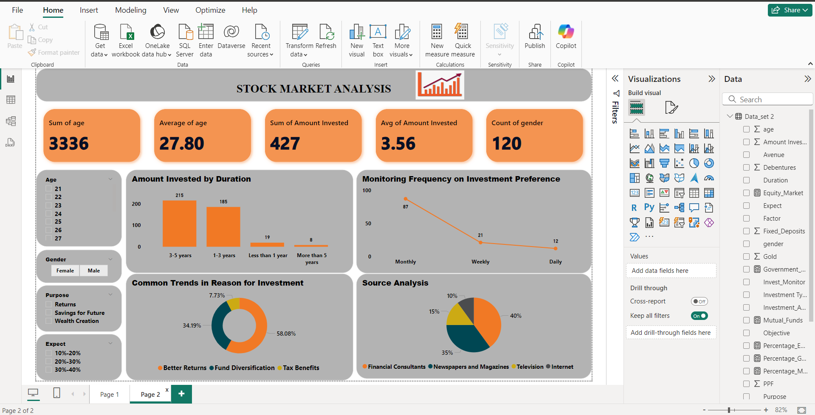
7. COMBINE ALL INSIGHTS INTO A DASHBOARD:
Finalization: Polish the dashboard for a professional appearance and user-friendly experience.

Slide 10
KEY LEARNINGS
TECHNICAL SKILLS
Data Cleaning and Manipulation: Gained proficiency in using Power Query for cleaning and preprocessing datasets, handling missing values, Duplicate Values.
Data Visualization: Enhanced ability to create insightful visualizations using Data Visualization Using Power BI. Created dashboards and plots that effectively communicated trends and patterns in the data.

Slide 11
SUMMARY
To summarize, our analysis has provided valuable insights into Data Exploration and summary, Gender based analysis, Objective Analysis, Investment Duration and Frequency, Reason for Investment, Source of Information on Stock Market Analysis. Moving forward, we recommend, which are designed to leverage these insights and drive growth.
Thank you for your attention. I’m happy to answer any questions or discuss any aspects of the analysis in more detail.

Slide 12


